Slide 1
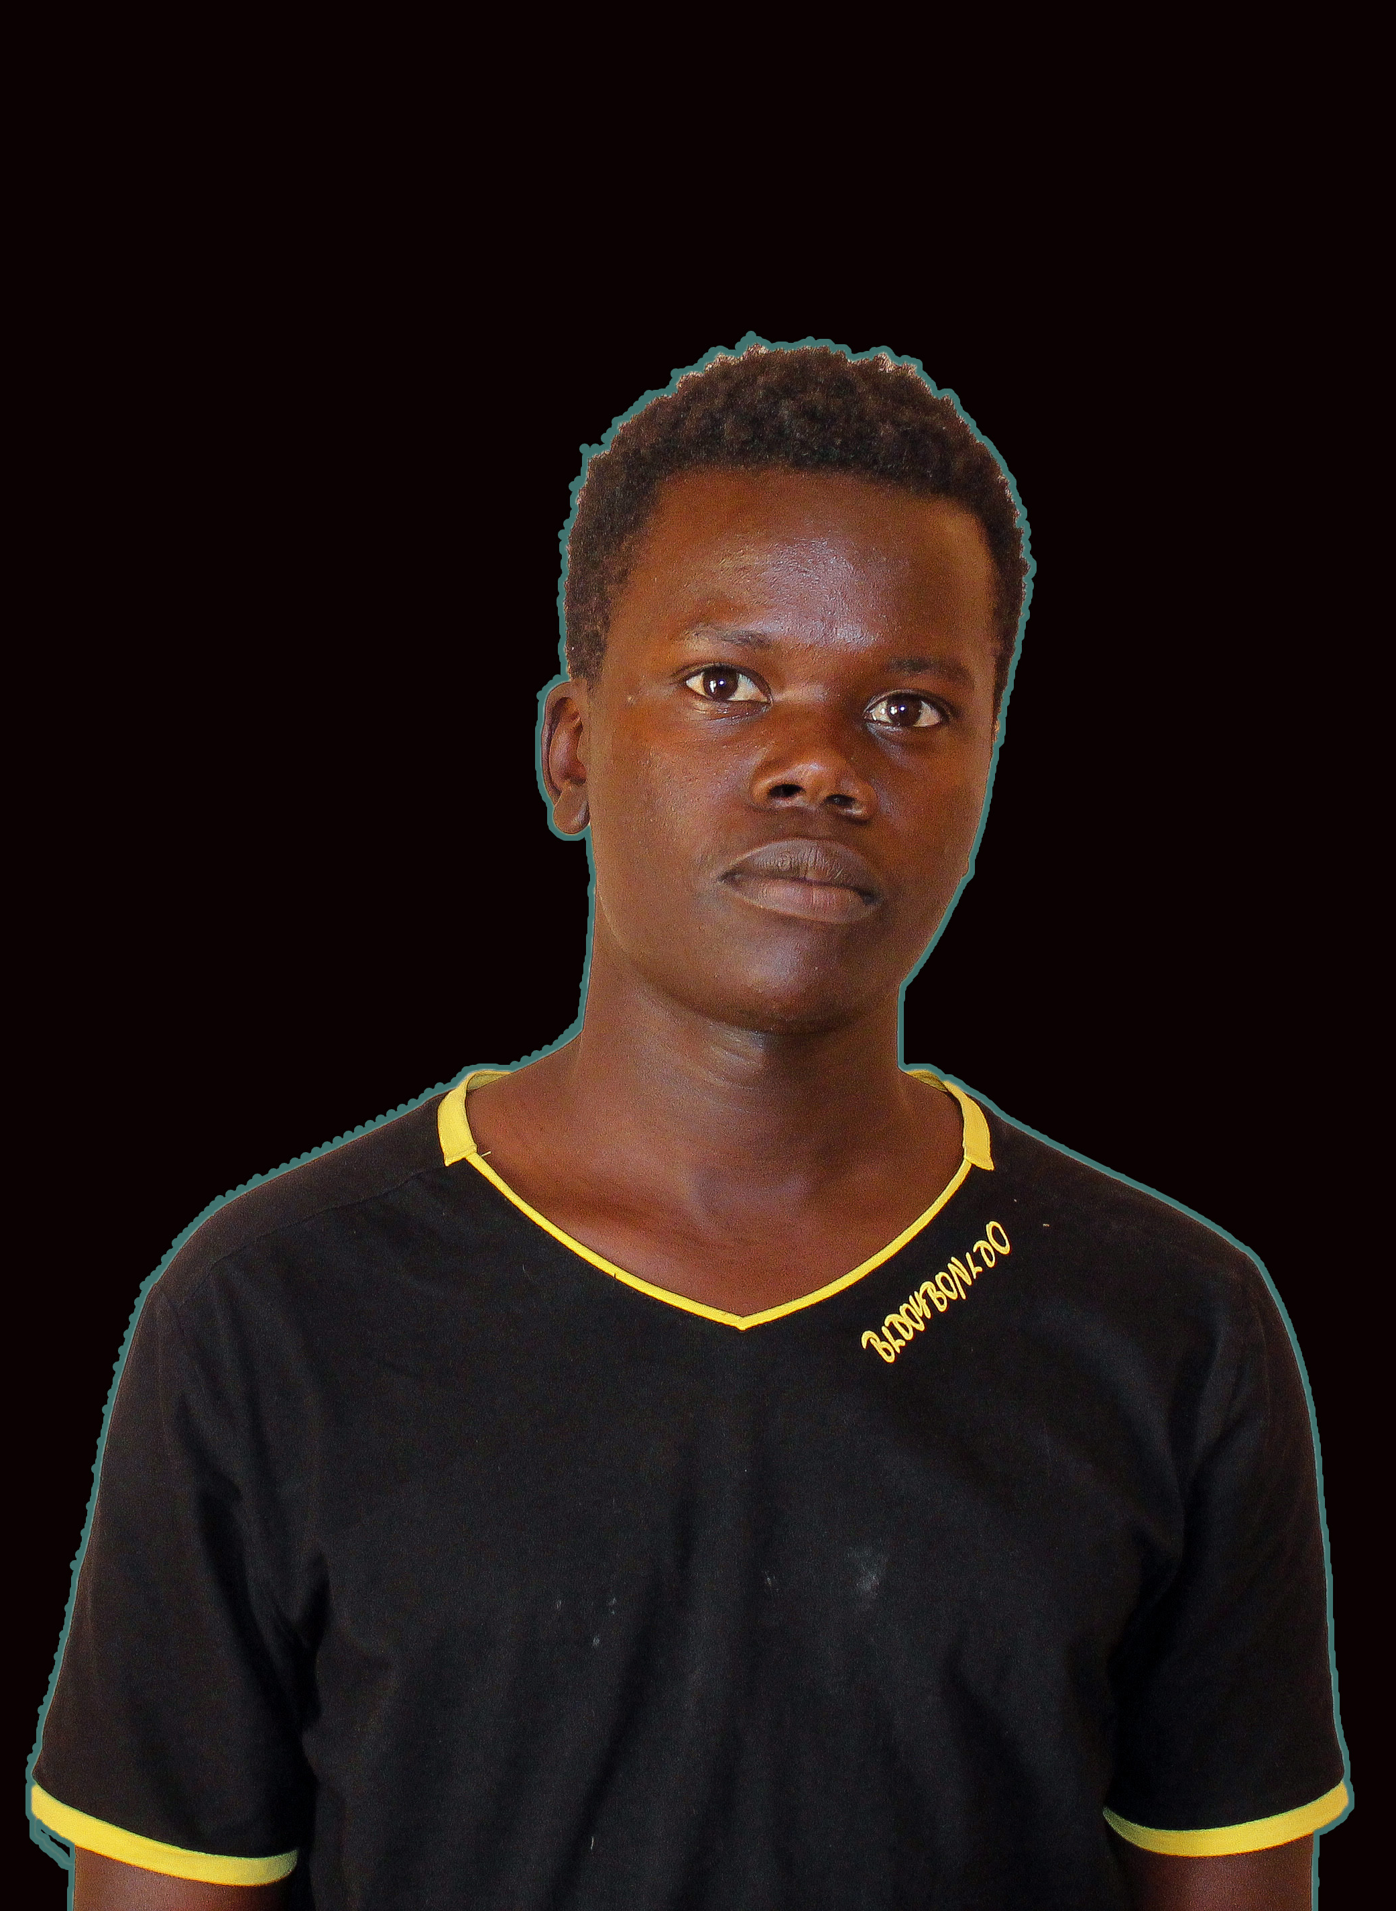
My names are KIBET EMMANUEL
Am 20 years old, undertaking a course: Certificate in Environmental Health Sciences(CEHS) School Of Hygiene – Mbale.
I reside in Amudat Town Council, Amudat District, Karamoja sub region, North Eastern Uganda.

Slide 2
Tools I used to code my website
Git bash. This was our terminal for running git commands. It helped us to save our work to our respective repositories in git hub and any other changes in our file folders.
Its very interesting when putting these commands in git bash, the way the respond makes me feel like a hacker or something.
Commands I know so far;-
cd - changing directory
Code . – for opening our repository folders in Vs code automatically
git init - creats new repository if you didn’t have one
git clone – for copying our repository from git hub to desktop or a directory you wish to put.
git status, git add . ,git commit –m “#”, git push –u master among others.
Vs Code: This was the code editor that was recommended by our good facilitators.
We used Vs code to;-
Write our HTML
Creat CSS
Connecting our HTML file with CSS and also use its pulgin: Live server to open our websites/run our HTML/CSS projects in Chrome.

Slide 3
MY WEBSITE
About my website

Slide 4

DomosBrands Domos’ Logos
I created my logo websites to help people to make Logos for their brands and businesses as it gives them opportunity to customize to what they think their Logos should be.
To enable artists to transit to the new technology and create their logos not only in paper but also in smart machines and may be earn from it.
I also created my website to test my capability and progress in HTML/CSS coding.
I am familiar to designing softwares like Photoshop, Illustrator and CorelDraw; so am an artist too, that’s also a reason I made a website about logos.

